Slide 2
Overview
Part 2 – Combinational Logic
  3-5 Combinational functional blocks
  3-6 Rudimentary logic functions
  3-7 Decoding using Decoders
    Implementing Combinational Functions with Decoders
  3-8 Encoding using Encoders
  3-9 Selecting using Multiplexers
    Implementing Combinational Functions with Multiplexers
Chapter 3 <number>

Slide 3
3-5 Combinational functional blocks
The functions considered are those found to be very useful in design
Corresponding to each of the functions is a combinational circuit implementation called a functional block.
In the past, functional blocks were packaged as small-scale-integrated (SSI), medium-scale integrated (MSI), and large-scale-integrated (LSI) circuits.
Today, they are often simply implemented within a very-large-scale-integrated (VLSI) circuit.
Chapter 3 <number>

Slide 4
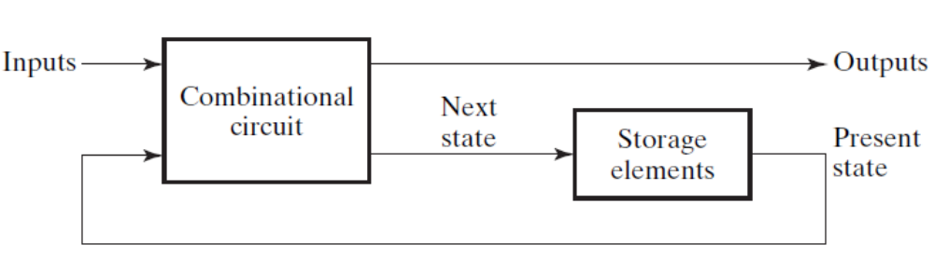
Combinational functional blocks
The functions and functional blocks discussed in this chapter are combinational. However, they are always combined with storage elements to form sequential circuits.
Combinatorial
Logic
Circuit
m Boolean Inputs
n Boolean Outputs
Fig. 3-11 Block of sequential
Chapter 3 <number>

Slide 5
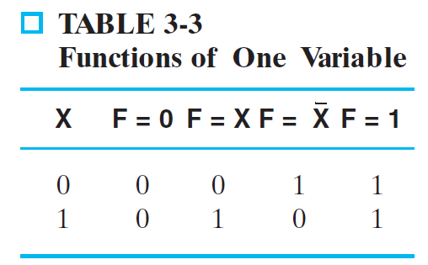
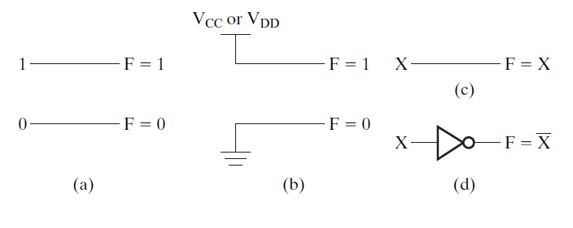
3-6 Rudimentary Logic Functions
Functions of a single variable X
Can be used on the
inputs to functional
blocks to implement
other than the block’s
intended function
Fig. 3-12
Chapter 3 <number>

Slide 6
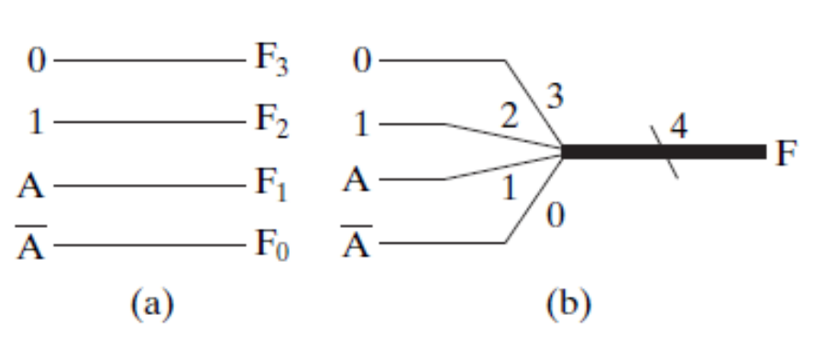
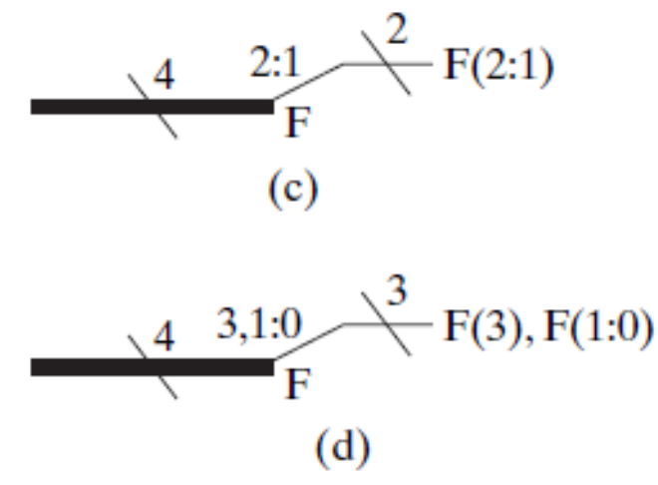
Multiple-bit Rudimentary Functions
Multi-bit Examples:
A wide line is used to represent
a bus which is a vector signal
In (b) of the example, F = (F₃, F₂, F₁, F₀) is a bus.
The bus can be split into individual bits as shown in (b)
Sets of bits can be split from the bus as shown in (c)
for bits 2 and 1 of F.
The sets of bits need not be continuous as shown in (d) for bits 3, 1, and 0 of F.
Chapter 3 <number>

Slide 7
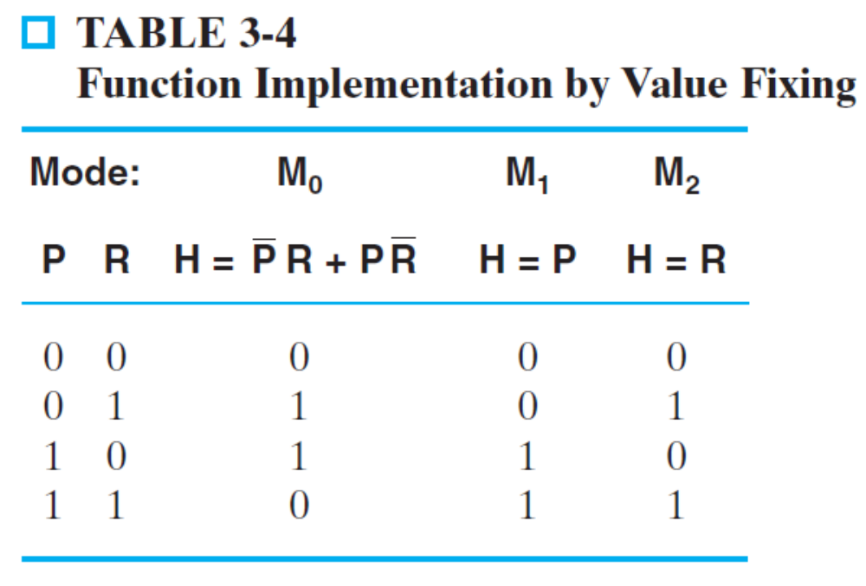
Example 3-8 Lecture-hall lighting control using value fixing
P, R: two switches in different position
H: the light to be controlled by P and R
Mi, i= 1, 2, 3 three different modes of light
Ii, i=1, 2, 3, 4 mode control signal
Chapter 3 <number>

Slide 8
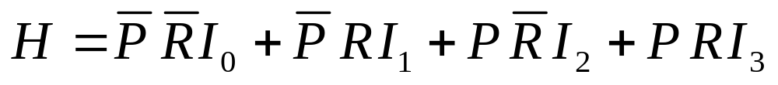
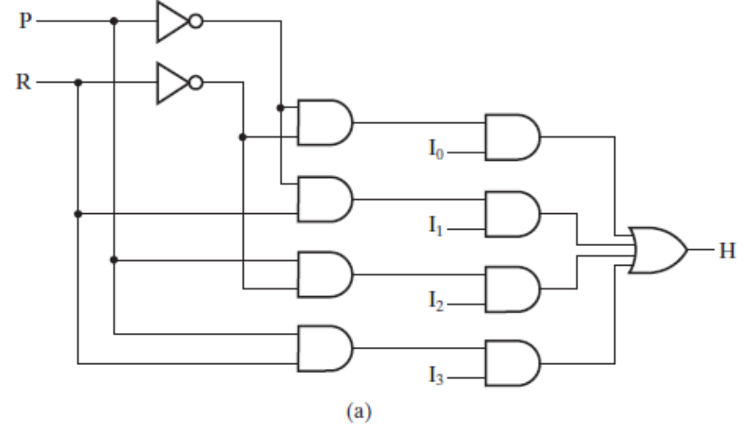
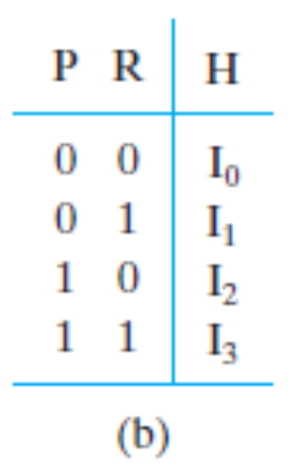
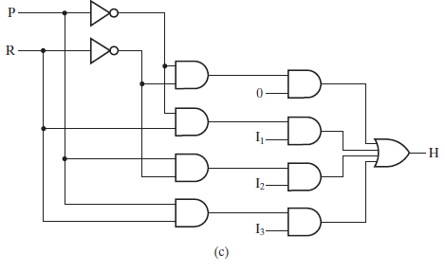
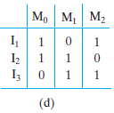
Chapter 3 <number>

Slide 9
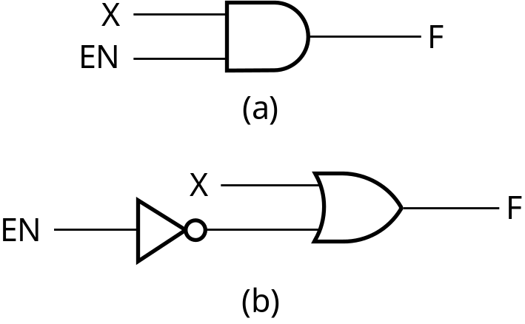
Enabling Function
Enabling: permits an input signal to pass through to an output
Disabling: blocks an input signal from passing through to an output, replacing it with a fixed value
The value on the output when it is disable can be Hi-Z (as for three-state buffers and transmission gates), 0 , or 1
When disabled, 0 output
When disabled, 1 output
Chapter 3 <number>

Slide 10
3-7 Decoding
Decoding - the conversion of an n-bit input code to an m-bit output code with
n ≤ m ≤ 2^{n} such that each valid code word produces a unique output code
Circuits that perform decoding are called decoders
Here, functional blocks for decoding are
  called n-to-m line decoders, where m ≤ 2^{n}, and
  generate 2^{n} (or fewer) minterms for the n input variables
Chapter 3 <number>

Slide 11
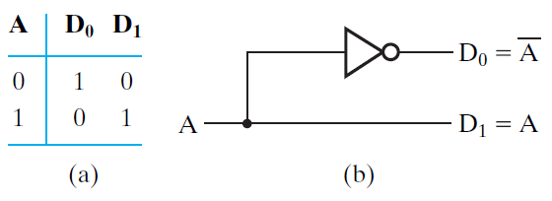
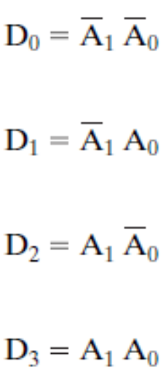
Decoder Examples
1-to-2-Line Decoder
2-to-4-Line Decoder
A
0
A
1
A
0
D
0
D
1
D
2
D
3
A
1
0
0
1
0
0
0
0
1
0
1
0
0
1
0
0
0
1
0
1
1
0
0
0
1
(a)
Note that the 2-to-4-line
decoder made up of two
1-to-2- line decoders and
4 AND gates.
(b)
Chapter 3 <number>

Slide 12
Decoder Expansion
A general procedure is given in book for any decoder with n inputs and 2^{n} outputs.
This procedure builds a decoder backward from the outputs.
The output AND gates are driven by two decoders with their numbers of inputs either equal or differing by 1.
These decoders are then designed using the same procedure until 2-to-1-line decoders are reached.
The procedure can be modified to apply to decoders with the number of outputs ≠ 2^{n}
Chapter 3 <number>

Slide 13
Decoder Expansion - Example 1
3-to-8-line decoder
  Number of output ANDs = 8
  Number of inputs to decoders driving output ANDs = 3
  Closest possible split to equal
    2-to-4-line decoder
    1-to-2-line decoder
  2-to-4-line decoder
    Number of output ANDs = 4
    Number of inputs to decoders driving output ANDs = 2
    Closest possible split to equal
      Two 1-to-2-line decoders
See next slide for result
Chapter 3 <number>

Slide 14
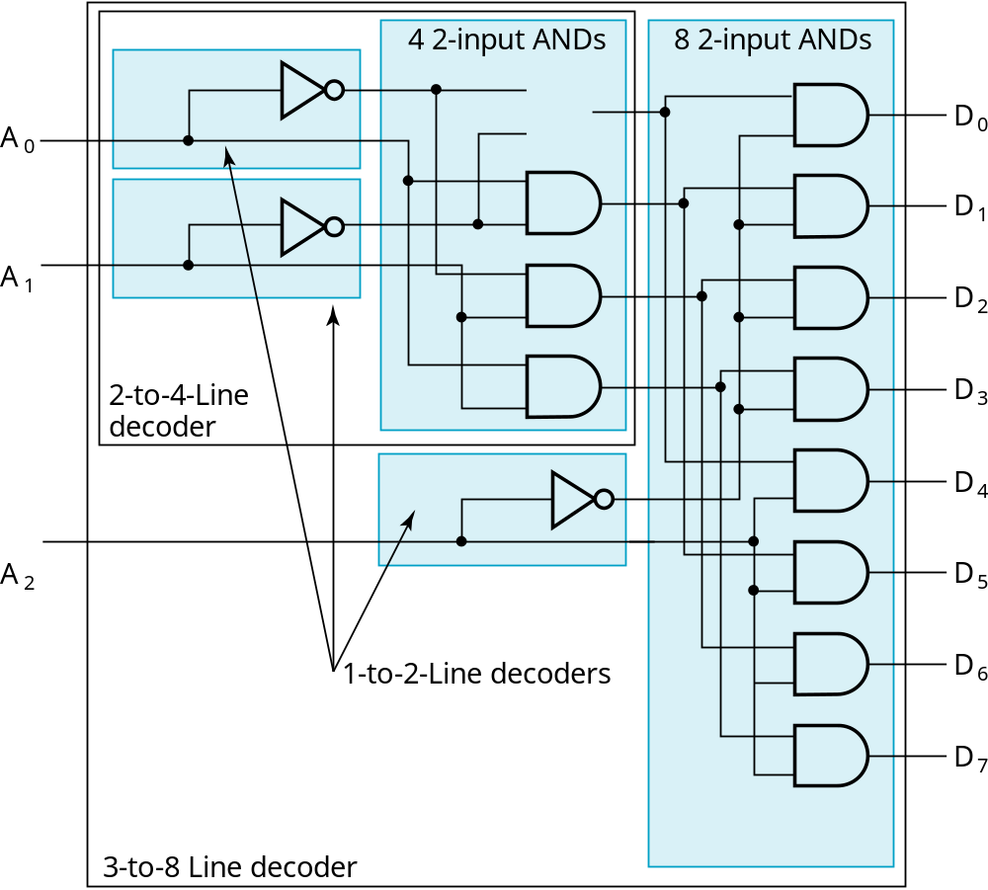
Decoder Expansion - Example 1
Result
Chapter 3 <number>

Slide 15
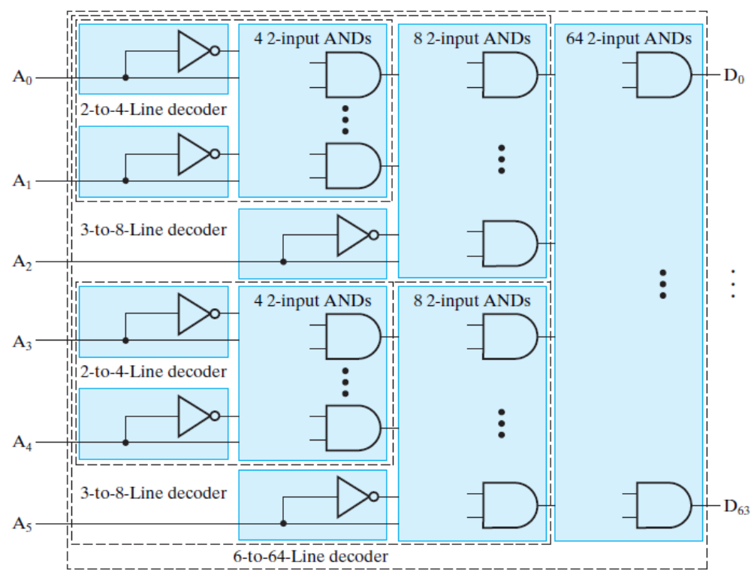
Decoder Expansion - Example 2
Chapter 3 <number>

Slide 16
Decoder Expansion - Example 3
7-to-128-line decoder
  Number of output ANDs = 128
  Number of inputs to decoders driving output ANDs = 7
  Closest possible split to equal
    4-to-16-line decoder
    3-to-8-line decoder
  4-to-16-line decoder
    Number of output ANDs = 16
    Number of inputs to decoders driving output ANDs = 2
    Closest possible split to equal
      2 2-to-4-line decoders
  Complete using known 3-8 and 2-to-4 line decoders
Chapter 3 <number>

Slide 17
Decoder Expansion - Example 4
d_{a}(A, B, C, D)
d_{b}(A, B, C, E)
d_{c}(C, D, E, F)
Solutions:
1. (A, B) shared by d_{a} and d_{b}; (C, D) shared by d_{a} and d_{c}
2. (A, B) shared by d_{a} and d_{b}; (C, E) shared by d_{b} and d_{c};
3. (A, B, C) shared by d_{b} and d_{a}
Cost computation:
1. and 2. save 2×8(2-to-4)= 16 gate cost; 3. saves 24 gate cost (3-to-8), in which inverters are excluded
Which tactic is better?
Chapter 3 <number>

Slide 18
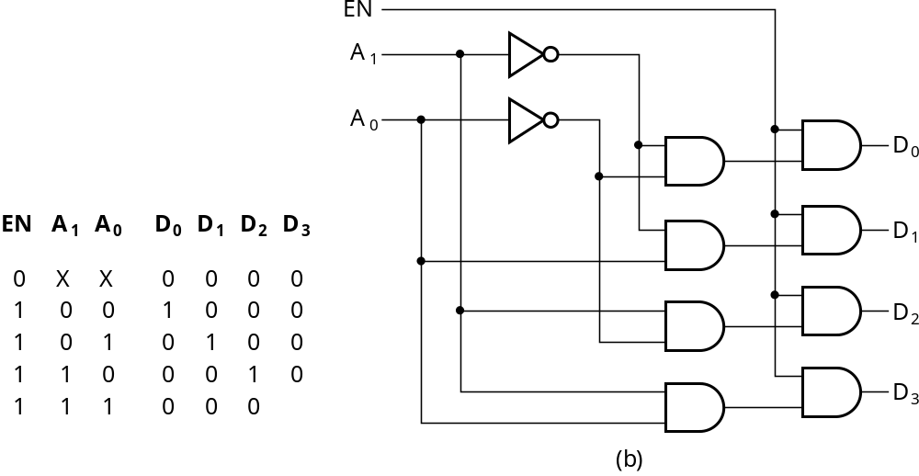
Decoder with Enable
In general, attach m-enabling circuits to the outputs
See truth table below for function
  Note use of X’s to denote both 0 and 1
  Combination containing two X’s represent four binary combinations
Alternatively, can be viewed as distributing value of signal EN to 1 of 4 outputs
In this case, called a
demultiplexer
Chapter 3 <number>

Slide 19
Decoder-based Combinational Circuits
- Decoder and OR Gates
Implement m functions of n variables with:
  Sum-of-minterms expressions
  One n-to-2^{n}-line decoder
  m OR gates, one for each output
Approach 1:
  Find the truth table for the functions
  Make a connection to the corresponding OR from the corresponding decoder output wherever a 1 appears in the truth table
Approach 2
  Find the minterms for each output function
  OR the minterms together
Chapter 3 <number>

Slide 20
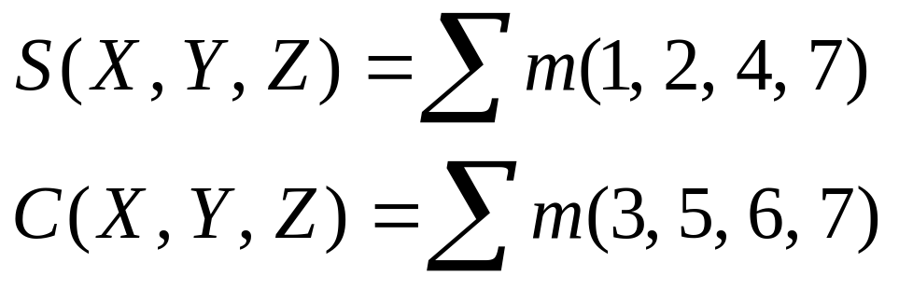
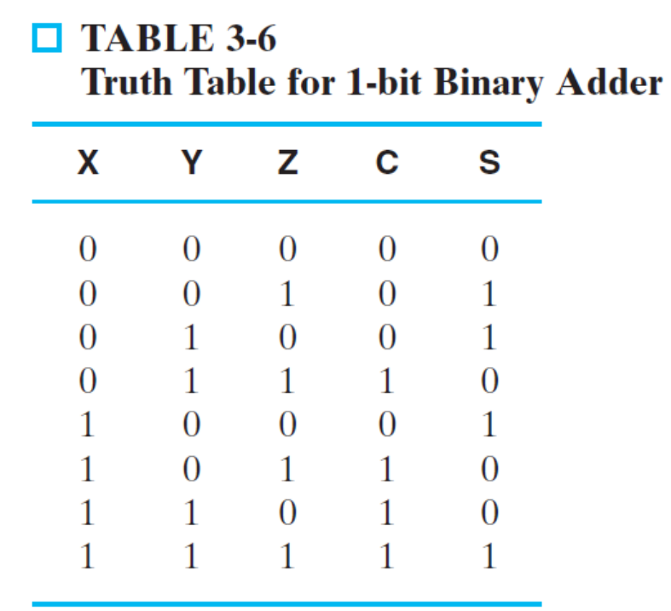
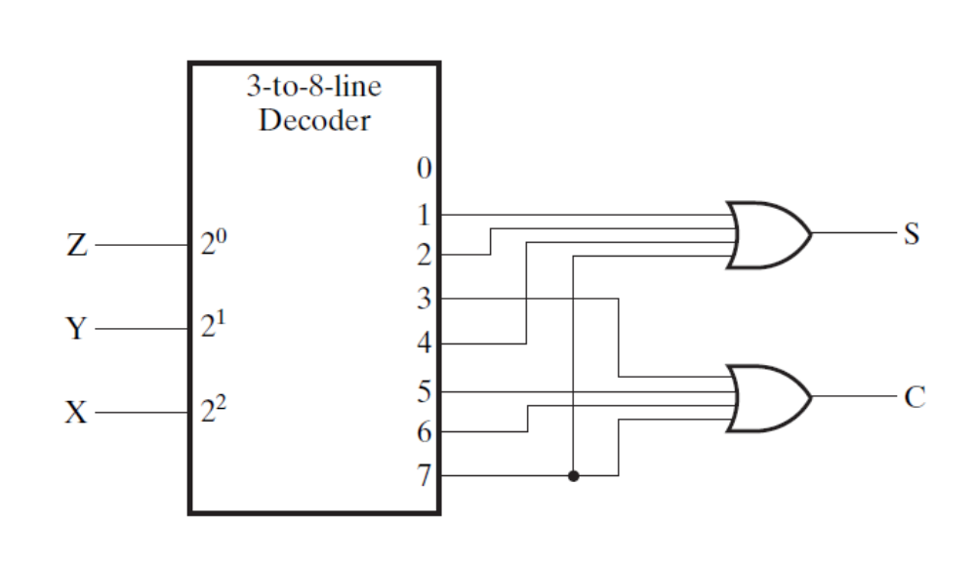
Example 3-11 1-bit Binary Full Adder
Chapter 3 <number>

Slide 21
3-8 Encoding
Encoding - the opposite of decoding - the conversion of an m-bit input code to a n-bit output code with n ≤ m ≤ 2^{n} such that each valid code word produces a unique output code
Circuits that perform encoding are called encoders
An encoder has 2^{n} (or fewer) input lines and n output lines which generate the binary code corresponding to the input values
Typically, an encoder converts a code containing exactly one bit that is 1 to a binary code corres-ponding to the position in which the 1 appears.
Chapter 3 <number>

Slide 22
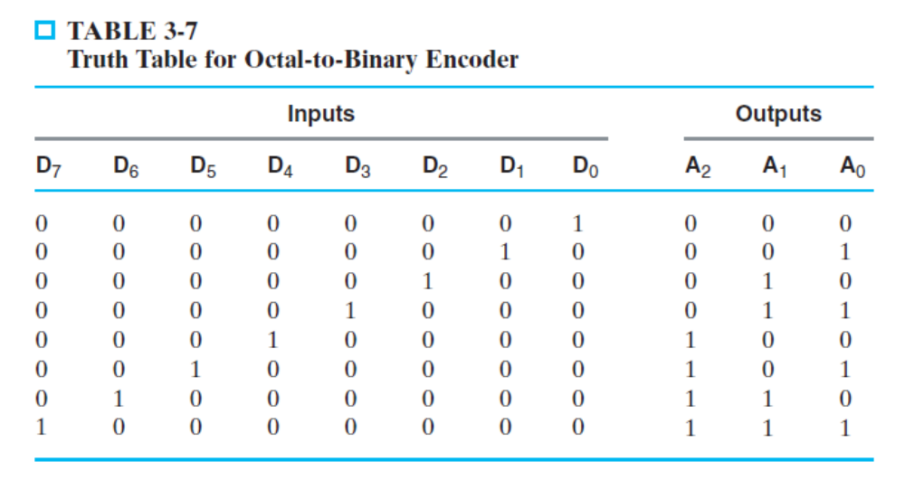
Encoder Example
Octal-to-Binary Encoder
  A₂ = D₄ + D₅ + D₆ + D₇
  A₁ = D₂ + D₃ + D₆ + D₇
  A₀ = D₁ + D₃ + D₅ + D₇
Chapter 3 <number>

Slide 23
Priority Encoder
If more than one input value is 1, then the encoder just designed does not work.
One encoder that can accept all possible combinations of input values and produce a meaningful result is a priority encoder.
Among the 1s that appear, it selects the most significant input position (or the least significant input position) containing a 1 and responds with the corresponding binary code for that position.
Chapter 3 <number>

Slide 24
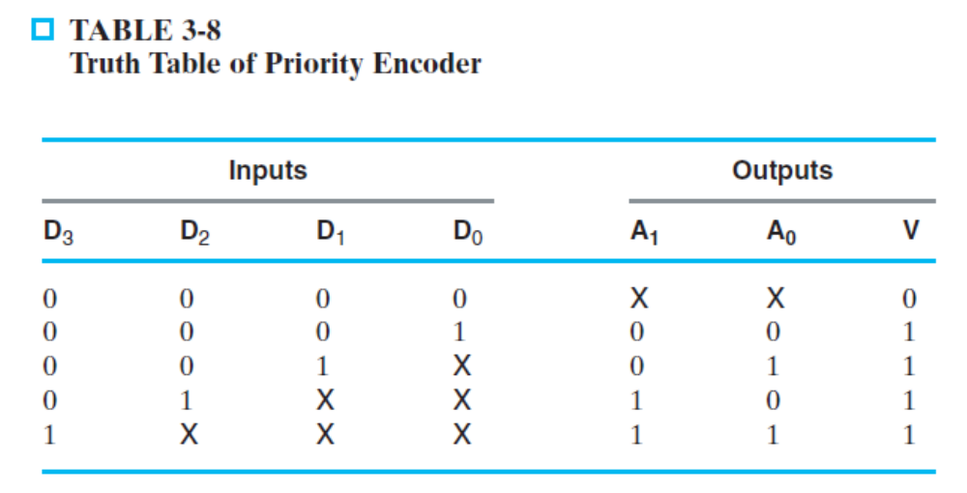
Priority Encoder Example
Priority encoder with 4 inputs (D₃, D₂, D₁, D₀) - highest priority to most significant 1 present - Code outputs A1, A0 and V where V indicates at least one 1 present.
Xs in input part of table represent 0 or 1; thus table entries correspond to product terms instead of minterms. The column on the left shows that all 16 minterms are present in the product terms in the table
Chapter 3 <number>
Notes:
Go over table explaining how entries were obtained, particularly those containing Xs

Slide 25
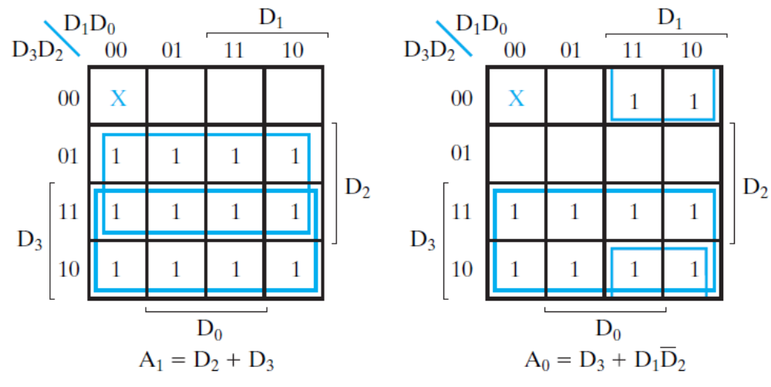
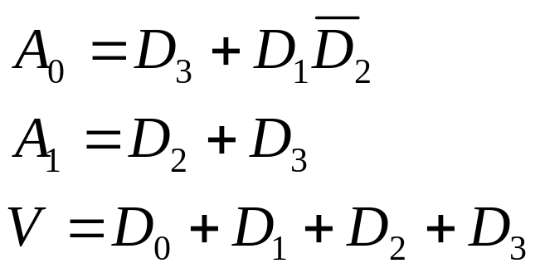
Priority Encoder Example (continued)
Chapter 3 <number>

